Slide 1
MACHINE LEARNING
PROJECT WORK

Slide 2
TABLE OF CONTENT
Id | Table of Content | Location
1 | Data Files | E-Learning
2 | Project files and python notebook | GitHub Repository
3 | Detailed Project Report | GitHub Repository
4 | Detailed Documentation with Readme file | GitHub Repository
5 | Other Files: Embeddings, Images | GitHub Repository
6 | Dataset description | Page 4
7 | Conclusion | Page 7

Slide 3
PROJECT FILES, REPORT AND DOCUMENTATION
GITHUB LINK: https://github.com/Neelansh01/ML-Project-Work
In the project repository:
Project files with classes implemented for all the Classifier and Pretrained models.
Project Report.
Documentation (steps/sequence to go through the project files and notebooks and the result files).
Dataset Analysis.
Visualizations.
Complete comparison of different classifiers across various derived embeddings.
Critical Findings.
Conclusions

Slide 4
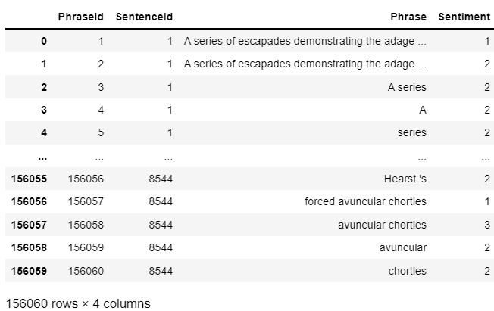
DATASET INTRODUCTION
Features: {PhraseId, SentenceId, Phrase, Sentiment}
Rows: 156060
Columns: 4
Rows utilized: 10000
(for the sake of enabling computation for all the
models like GBDT which take a lot of time.)
Output Classes: 5

Slide 5
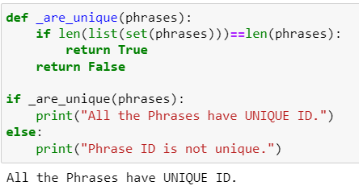
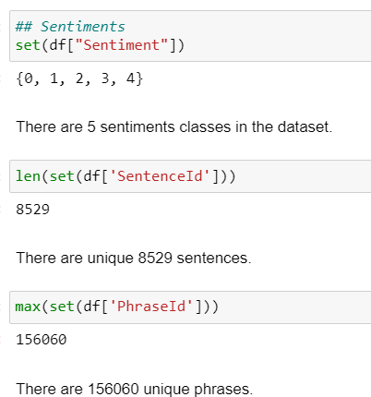
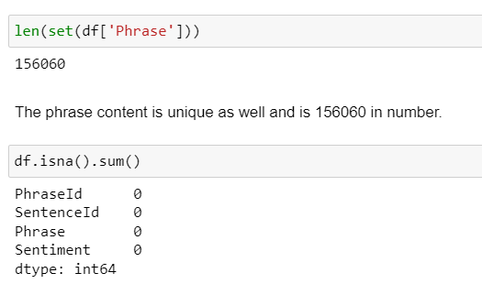
DATASET INTRODUCTION

Slide 6
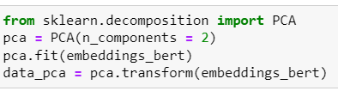
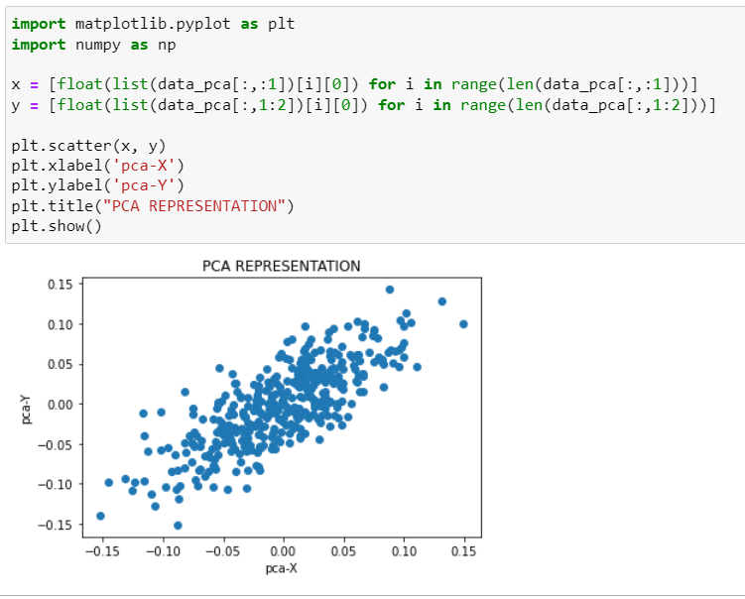
PHRASES PLOTTING IN 2-D USING PCA

Slide 7
CONCLUSION
The dataset used for analysis contains simple English sentences.
The sentences are broken into phrases which are unique with an Id in the dataset. Phrases need not be further filtered as they are already clean in this dataset.
The phrases will be analyzed through embedding and classification models for sentiment classification.
The phrases are of similar type and they can be represented with 8% variance over 2 PCA components to be clustering around a centre point.
The dataset is complete with no missing values.
For homogeneity we will shuffle the dataset and use a sample of 10000 records in our analysis.

